Slide 1
Installation Guide
(JDK – JDK 6 Update 14)
2011. 03. 10
CODELABOR

Slide 2
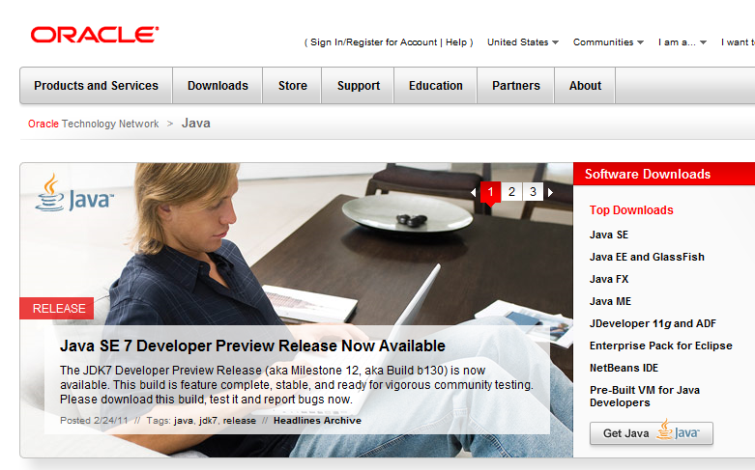
JDK
Site
Official Site: http://www.oracle.com/technetwork/java

Slide 3
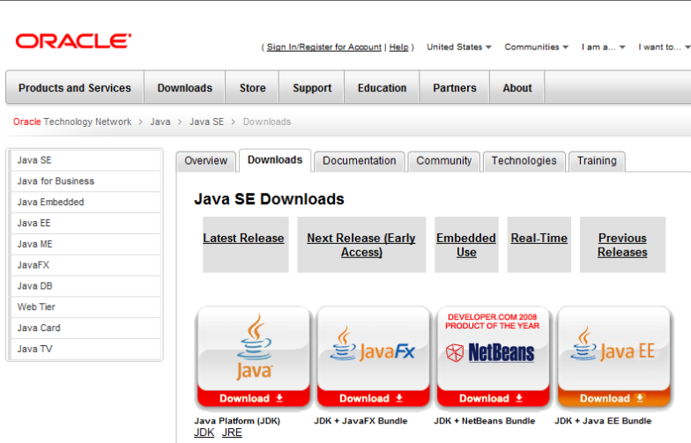
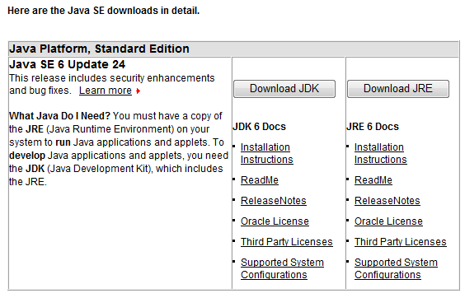
JDK
Download
Download Site URL: http://java.sun.com/javase/downloads/index.jsp
Package: JDK 6 Update 24

Slide 4
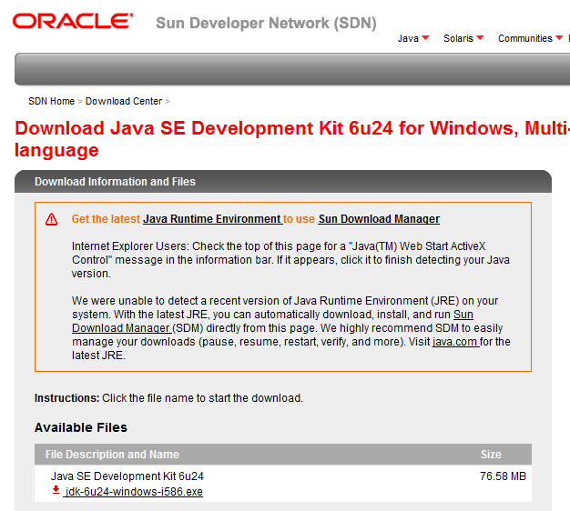
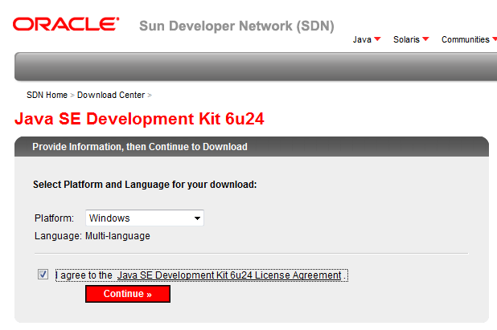
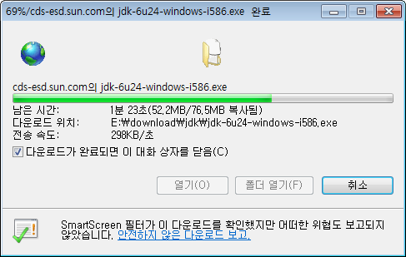
JDK
Download
Platform: Windows
Language: Multi-language
File: jdk-6u24-windows-i586.exe

Slide 5
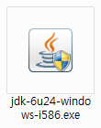
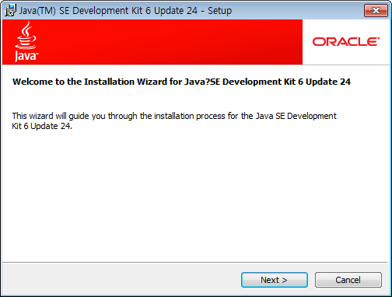
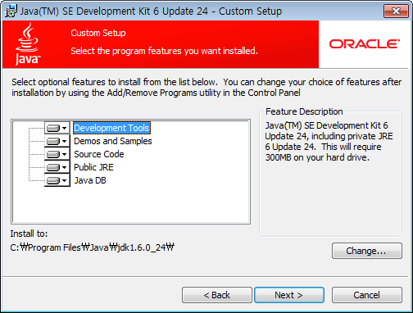
JDK
Install
Install Directory
  C:\Program Files\Java\jdk1.6.0_24\

Slide 6
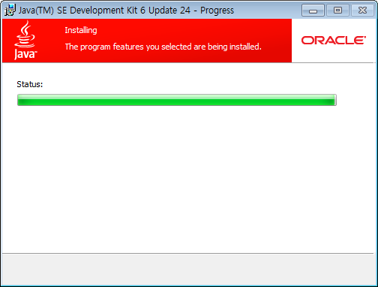
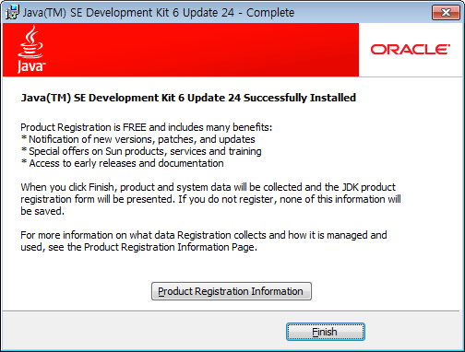
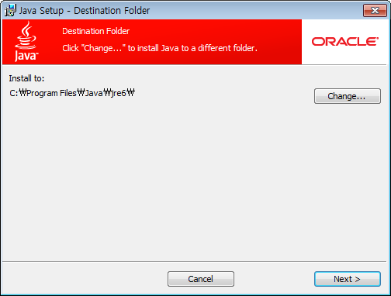
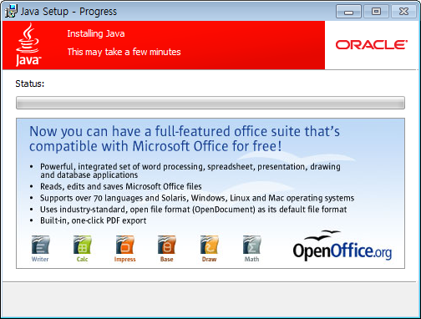
JDK
Install
Install Directory
  C:\Program Files\Java\jre6

Slide 7
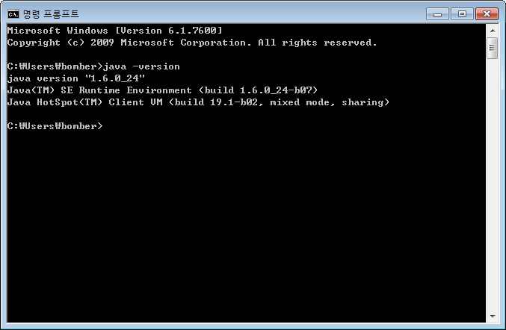
JDK
Version Check
Version
  명령 프롬프트 새로 띄우기
  버전 확인 방법: java –version

